Slide 1
ODOT’s Table of Organization & Partnering
Jim Barna
Assistant Director of Transportation Policy
March 17, 2011

Slide 3
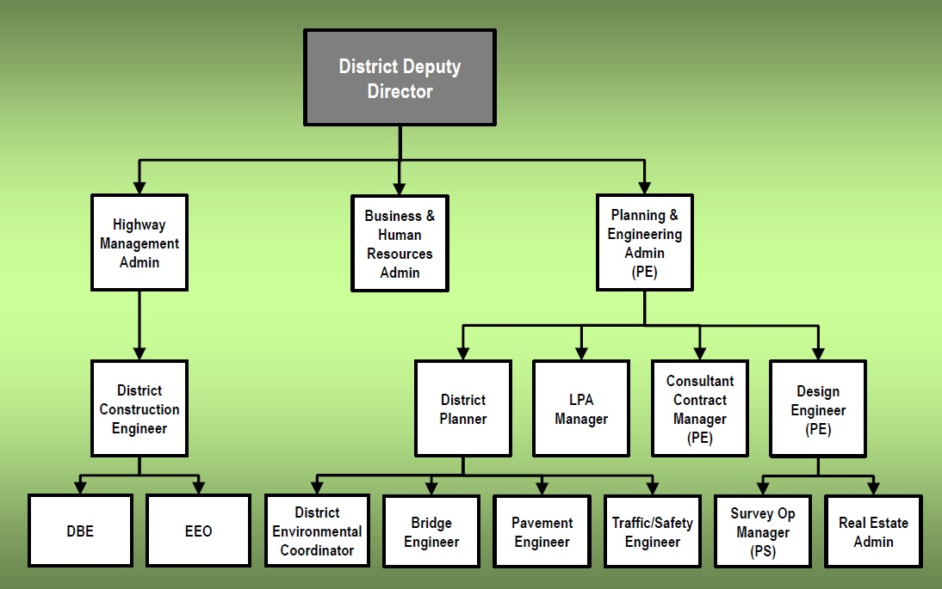
District Table of Org.

Slide 4
Partnering

